Slide 1
2025 Troop Cookie
Manager Training
Managing the Cookies
Notes:
Welcome to the third session for the 2025 TCM Training – Managing the Cookies.

Slide 2
Online Training Series
Five Training Videos
Cookie Program Overview
Engaging Troops and Girls
Managing the Cookies
Managing the Cookie Finances
Smart Cookies and Digital Cookie
Notes:
This session is filled with information on managing the cookies, including the initial cookie order, cookie transfers, and visiting cookie cupboards. Let’s get started.

Slide 3
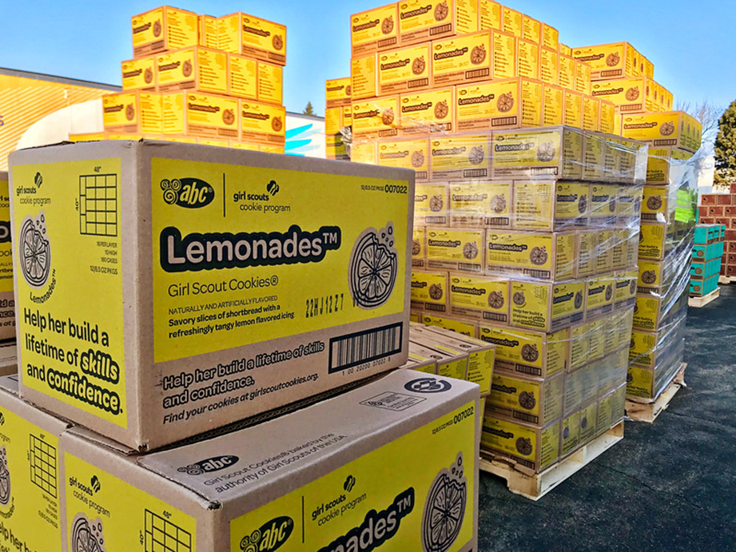
Section Topics
Meet the cookies
Placing an Initial Order and Gluten-Free Cookie Order
Cookie Deliveries
Cookie Cupboards
Cookie Inventory Management
Notes:
In this overview, you’ll learn about:
Learn about the 9 Cookie varieties
We’ll go over The Initial Cookie Order & Gluten-Free Cookie order
Next, we’ll take a look at Cookie deliveries
We’ll go over the different types of cookie cupboards
And last, we’ll talk about ways to manage your troops’ cookie inventory

Slide 4

Your Girl Scout Cookie Favorites Are Back!
Nine cookie varieties
All varieties are $6 per package
View nutritional & allergen information on Cookie Central, the order card, & in Smart Cookies
Final year of the Toast YAY! Cookie
Notes:
Your Girl Scout cookie favorites are back for another year! We’ll have nine cookie varieties, all at $6 per package. You can view the nutritional and allergen information on cookie central, on the cookie order card, and in Smart Cookies too. All cookies are certified kosher and Halal. We do have an update on a cookie that will be retiring. 2025 will be the final year for the Toast YAY. While we say goodbye to the Toast YAY after this season, we’ll welcome a new cookie to our line up in 2026!

Slide 5
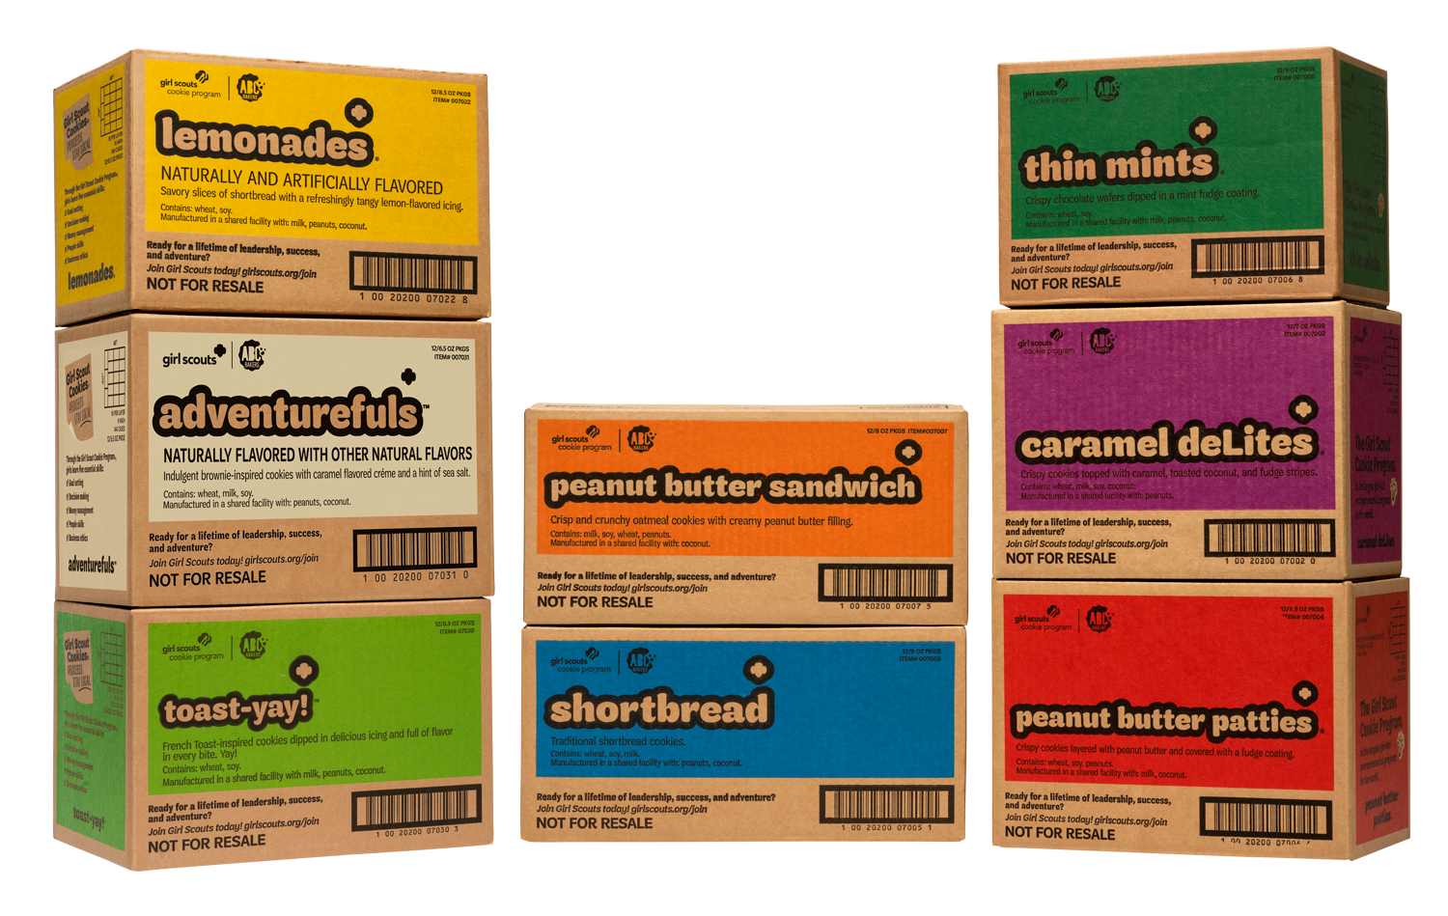
The Initial Cookie Order
Opportunity for troops to have cookies "on hand" to sell on Cookie & Booth Go Day, February 21
Nearly 70% of all cookies delivered in the initial order
Notes:
The initial cookie order, is an opportunity for troops to order their initial supply of cookies to have on hand to sell on Go Day. With the initial order, it is amazing to think that in the span of just one week, millions of packages of cookies get delivered across River Valleys to our troops and cookie cupboards. It takes the partnership of our delivery crews, volunteers, and staff (and a little magic) to make it all happen in that short timeframe. Last year, nearly 70% of all cookies sold were distributed through the initial order!

Slide 6
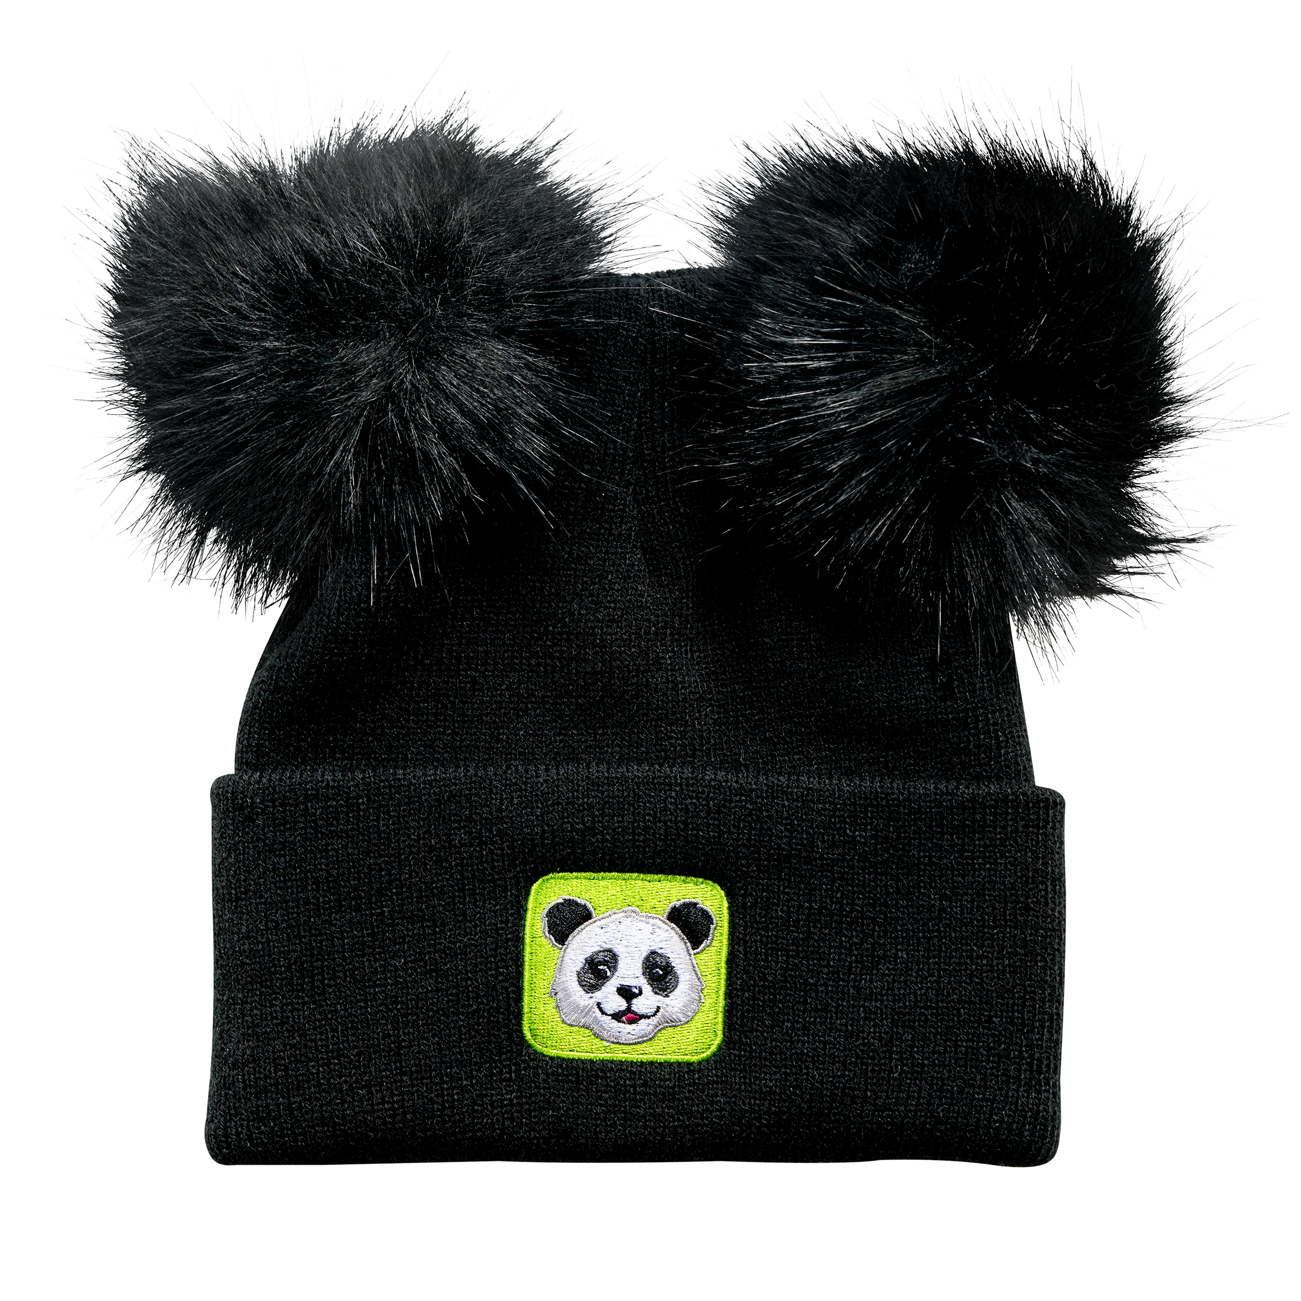

Initial Cookie Order: Due January 24
Using the Cookie Calculator
  Recommendations for new & returning troops
Advice to troops
  Know how your Girl Scouts want to participate
The initial order is for those who:
  Want cookies in hand on Go Day
  Want a supply of the gluten-free cookies
Initial Order Patch reward for troops
Notes:
You can begin entering your initial cookie order in Smart Cookies once you’ve received access the week of December 16. The initial cookie order deadline is January 24. The Cookie Calculator has been updated to provide recommendations on the initial order for both new and returning troops. The recommendation for returning troops will be based on their PGA from 2024. For new troops, the recommendation will be based on the Per Girl Average of your troop’s Girl Scout Grade level. Before the deadline, work with your families to determine how their Girl Scouts plan to sell cookies – online, in-person, or a combination of both. If they want to have cookies in hand on Go Day or if they intend to sell the gluten-free cookies, you will need to place an initial order. Troops who meet the Initial Order requirements will receive an Initial Order reward, the Ta-Ta Toast Yay patch for all girls selling. All troops that follow the Cookie Calculator recommendation will also be entered into a drawing to be randomly selected to win Panda Pom-Pom hats for the entire troop! Winners will be announced in The Cookie Press.

Slide 7

Gluten-Free Caramel Chocolate Chip Cookies*
For troops that placed a pre-order:
Watch for email reminder with order in early January
Troops who placed a pre-order must also include them in their initial order in Smart Cookies
For new troops or troops that did not place a pre-order:
Limit of two cases per troop
Exception request process in The Cookie Press
*Not guaranteed to be in stock at cupboards
Notes:
In October, we offered troops a chance to place their pre-order for the gluten-free caramel chocolate chip cookies.
For troops that did place a pre-order, an email reminder with your order quantity will be sent in early January. When troops complete their Initial Order, they can decrease the order if needed.
It’s important to note that you will need include the number of cases of GF Caramel Chocolate Chip cookies you pre-ordered in your IO in Smart Cookies. For new troops or troops that did not place a pre-order, there will be a two case per troop limit. However, if your troop does need more than two cases, we’ll grant exceptions to the two-case limit if we have any extra supply left after the Initial Order deadline. Watch for details on this exception process coming in The Cookie Press in January. Remember, we do not guarantee that the gluten-free will be in stock in cookie cupboards. If we do have a supply at cupboards, we’ll announce the info also in The Cookie Press.

Slide 8
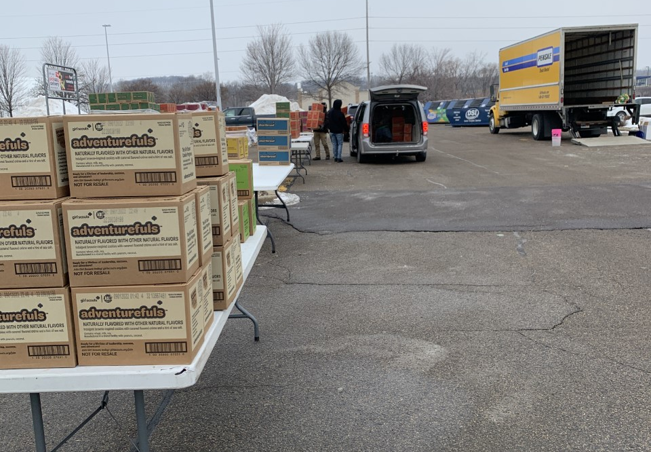
Initial Order Deliveries: February 13-20
Two types of initial order deliveries
•Mega Drop
•Mini Drop
Watch for details on what to expect in The Cookie Press
Notes:
The Initial Order deliveries will happen the week of February 13-20.
There are 2 types of deliveries; Mega Drops, which are held in our larger Metro Areas, including the Twin Cities, Rochester, and Mankato. Mini Drops serve our non-metro areas.
If you are unsure of which you are, check out the Community Delivery /Cupboard handout on Cookie Central, reach out to your Community Product Leader, or connect with our staff.
As a troop cookie volunteer, you’ll coordinate picking up the cookies and then distributing them to the troop families. As we get closer to the delivery timeframe, we’ll share reminders on what to expect at these deliveries in The Cookie Press.

Slide 9
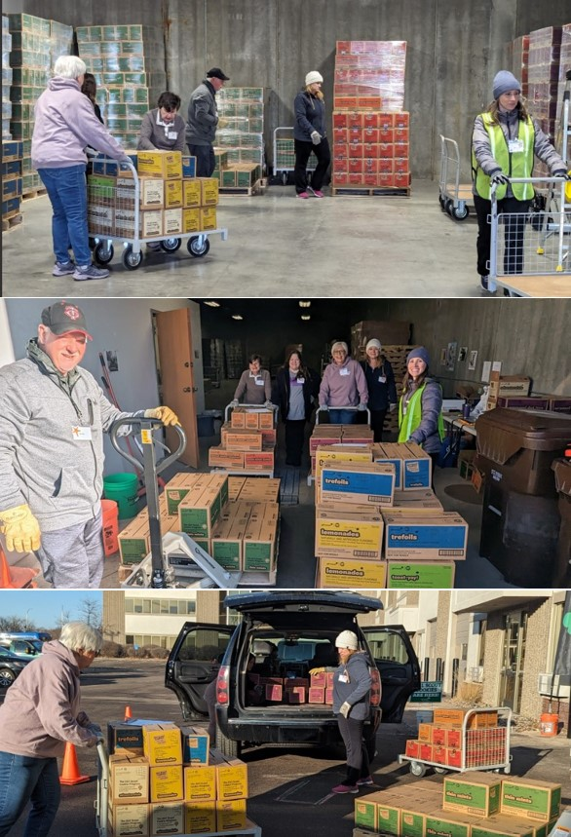
Cookie Cupboards*
Three types of Cookie Cupboards
  Council Cupboards: on demand orders
  Council Express: planned orders, full cases
  Regional Cupboards: planned orders
Pick up cookies by the case or package
  No packages at Council Express locations
Cookie exchange information in The Cookie Press
*Cupboard info coming to Cookie Central before Cookie Go Day
Notes:
When it comes to picking up additional cookies after the initial order, you can make a visit to a Cookie Cupboard.
We feature the 3 types of cupboards.
The council cupboards (both on-demand and express) are managed by River Valleys staff or one of our cookie delivery agents. Council cupboards are open to all River Valleys Troops. Most troops will utilize this type of cupboard.
The Regional cupboards are in our non-metro communities are managed by volunteers.
The hours, location, and details for all COUNCIL cupboards will be posted on Cookie Central prior to GO DAY.
Cookie Central also features our cookie inventory dashboard for the council cupboard locations, which will show the cookie varieties that are in stock, or alert if a variety is low or out of stock.
If your community utilizes a Regional Cupboard, your Community Product Leader will inform you of the location and the contact information. If you haven't received this information or know who that individual is, please reach out to us. The Regional Cupboards hours will also be posted on your troop Smart Cookies dashboard in February for reference.
Troops can still pick up cookies by the case or package, except at our council express locations. Keep an eye on The Cookie Press for an announcement regarding cookie exchanges. We’re still working on the dates and the details for the exchanges. This will NOT happen within the first two weeks of the season. Exchanges will be limited to full, bakery-sealed cases, so plan accordingly. And just a heads-up—Caramel Chocolate Chip cookies are not eligible for exchanges. We hope knowing exchanges will be available will help your troop to feel confident in placing an initial cookie order. All exchanges will be inspected by the cupboard staff before the volunteer or adult dropping them off leave. Any cases that are NOT sealed or have missing or other cookie packages inside will be turned away. River Valleys will also consider ending exchanges should we see frequent exchanges that are not following these guidelines.

Slide 10

Top Tips for Cookie Inventory Management
Maintain good records
Collect at least 50% of money owed before providing additional inventory
Set a firm cookie return date in each Family Guide
Set a cookie schedule
Remind families cookies must be in “sell-able” condition
Notes:
Managing the cookie inventory is one of the most important parts of your role as a troop cookie manager. We’ve heard from our cookie volunteers that following these best practices can be impactful on the troop’s experience to end the season with little to no leftover cookie inventory. Let’s review these top tips:
Maintain good records. This means you must provide families with a receipt each time cookies or money is exchanged. Keep copies of these receipts just in case of issues. They will be required if you need to complete a Finance Inventory Issue Form at the end of the season.
After providing families with an initial cookie order, collect at least 50% of money owed before providing additional inventory
Set a firm cookie return day with the families and write this date on The Family Guide & share it at the Family Cookie Meeting. If at any time during the sale a family finds that they have too much cookie inventory, they should communicate this to the troop in order to facilitate inventory movement to other girls.
Set a cookie schedule with families & stay in communication each week to keep tabs on inventory levels
Reinforce that all cookies should be kept in sell-able condition; troops can and should refuse any cookies that were not stored in appropriate areas (aka areas free of extreme temperature changes, pests, smoke, or other damaging effects).

Slide 11
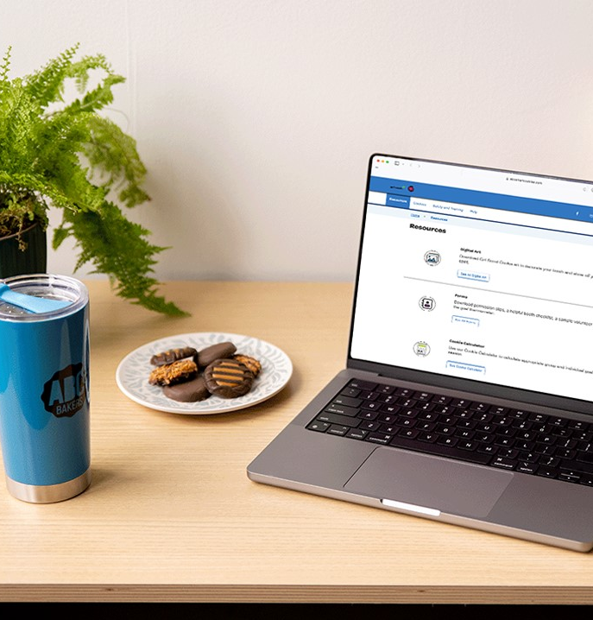
Managing Cookies Online with Smart Cookies
Record transfers & payments weekly
Review cupboard transfers for accuracy
Find instructions & videos in our Online Cookie Systems Guide for Volunteers on Cookie Central
Connect with your Community Product Leader or River Valleys staff if you have issues in Smart Cookies
Notes:
While you manage the physical cookie inventory, you will use the Smart Cookies online platform to manage the troop’s cookie business.
-You’ll use Smart Cookies to transfer cookies to girls to give them credit towards their rewards.
-To help track when a family has turned in cash/checks to the troop, add a financial transaction in Smart Cookies to credit the girl scout with the payment to reduce the balance due for cookie inventory. Use your receipts to help with entering both cookie transfers and crediting girls with payments.
-Review cupboard transfers for accuracy – mistakes happen! If you notice an incorrect transfer was made to your troop after a cupboard pick up, reach out to us as soon as possible. We’ll provide a form in The Cookie Press that can be used to inform us of these mistakes and our team is prepared to help get them corrected in Smart Cookies.
-Our online cookie systems guide on Cookie Central provides you with step by step instructions and also videos on managing Smart Cookies. If you need extra support, reach out to your Community Product Leader or to River Valleys directly. When you reach out, provide as much context and information as possible so that we can help you in a timely manner.

Slide 12

How to Handle Extra Cookie Inventory:
Schedule additional cookie booths or walkabouts
Business 2 Business sales
Cookie donations
Transfer cookies to other troops in need of inventory
Cookie Swap in Rallyhood
Notes:
If you find that your troop does have extra inventory as you get into the final days of the sale, here’s a few suggestions on how to handle the extra cookies:
Scheduling additional booths, walkabouts, or a cookie caravan to canvas neighborhoods for a last chance to buy cookies
Contacting businesses for a “b2b” Business to Business sale
Promote the troop donation option of the Cookie Share program utilizing excess inventory to fulfill the donations from customers
Save another troop a trip to the cookie cupboard and arrange for troop-to-troop transfers to move inventory to troops continuing to sell in your Community. Your Community Product Leader can also assist with troop-to-troop transfers.
Use the Cookie Swap Rallies in Rallyhood to connect with troops outside your community. We’ll share information on how to join these Cookie Swap Rallies in The Cookie Press.

Slide 13

Key Takeaways
The initial cookie order, the deadline for the order, & details on the gluten-free cookie availability
An overview of the types of cookie deliveries & cupboards
Top Tips for inventory management
Guidance on how to deal with excess inventory
Notes:
Here are your key takeaways from Managing the Cookies:
We went over the initial cookie order, the deadline for the order, & details on the gluten-free cookie availability
We looked at an overview of the types of cookie deliveries & cupboards
Top Tips for inventory management
And finally, guidance on how to deal with excess inventory

Slide 14
THANK YOU!
Next Up: Managing the Cookie Finances
Notes:
That’s a wrap on Managing the Cookies! The next video will focus on Managing the Cookie Finances, where we'll go over the Cookie Proceeds, payment options, finance deadlines, and more.

